Slide 1

Programming for Big Data Analytics
-Prof. Juan Rodriguez
Analysis on Air Quality Index
Aditya Jain(aj2419)
Gaurav Wadhawan(gw979)
Shrey Gupta(sg5085)

Slide 2



Analysis on Air Quality Index
The Team
The Team
Aditya Jain (aj2419) MS, Computer Science
Gaurav Wadhawan (gw979) MS, Computer Science
Shrey Gupta (sg5085) MS, Computer Scien
ce

Slide 3
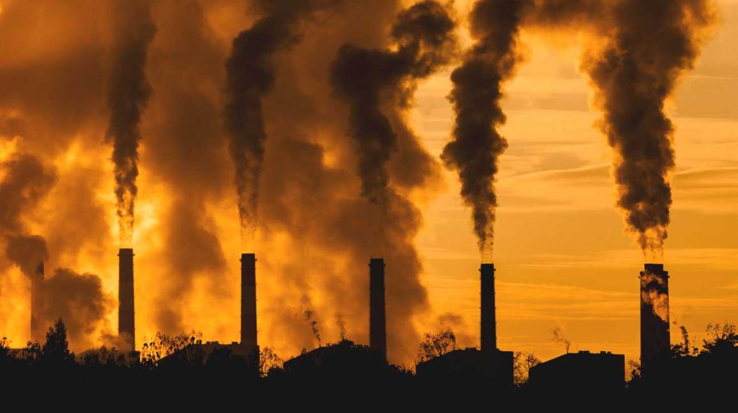
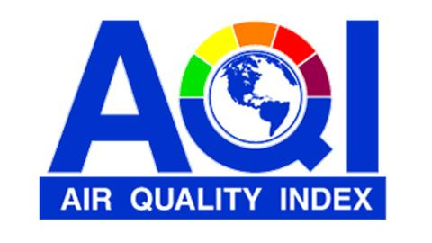
Air Pollution and Air Quality Index
Air pollution exists because of different pollutants such as :
-Sulphur Dioxide(SO₂) – caused by the fossil fuel combustion
-Carbon Monoxide(CO) – caused by the incomplete fuel combustion
-Nitrogen Dioxide(NO₂) – caused by traffic and industries.
-Ozone(O₃) – caused by the interaction of pollutants with UV
-Particulate Matter(PM) – caused by dust, soot, smoke etc.
Air Quality Index(AQI) is a measure used to calculate the levels of air pollution in reference to the different air pollutants that might be present in the area. The air quality standards may vary from region to region which further varies the AQI of different regions. Air Pollution Index, Pollutants Standard Index and Air Quality Health Index are few examples of different national air standards.

Slide 4

What was our objective?
-Visualization of air quality in different states.
-Quantify the pollution in different states.
-Evaluating factors responsible for bad AQI in different regions.

Slide 5
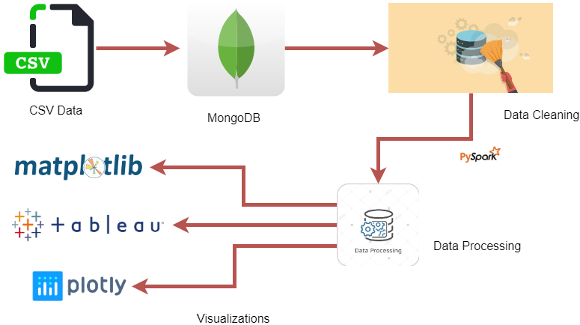
Pipeline

Slide 6
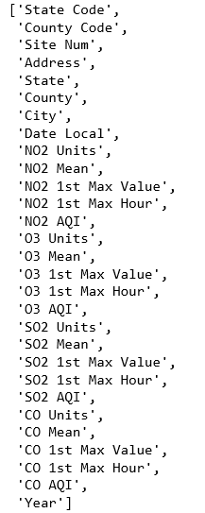

About the Dataset
The dataset we picked contains the pollution levels in USA. Different columns are present in the data to highlight air pollutants in areas. These columns act as features in further predictions if models are fitted onto this data

Slide 7
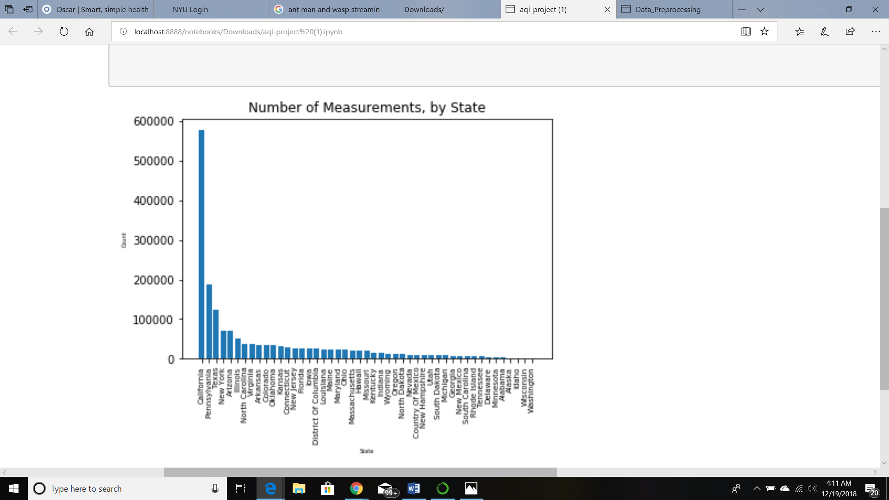
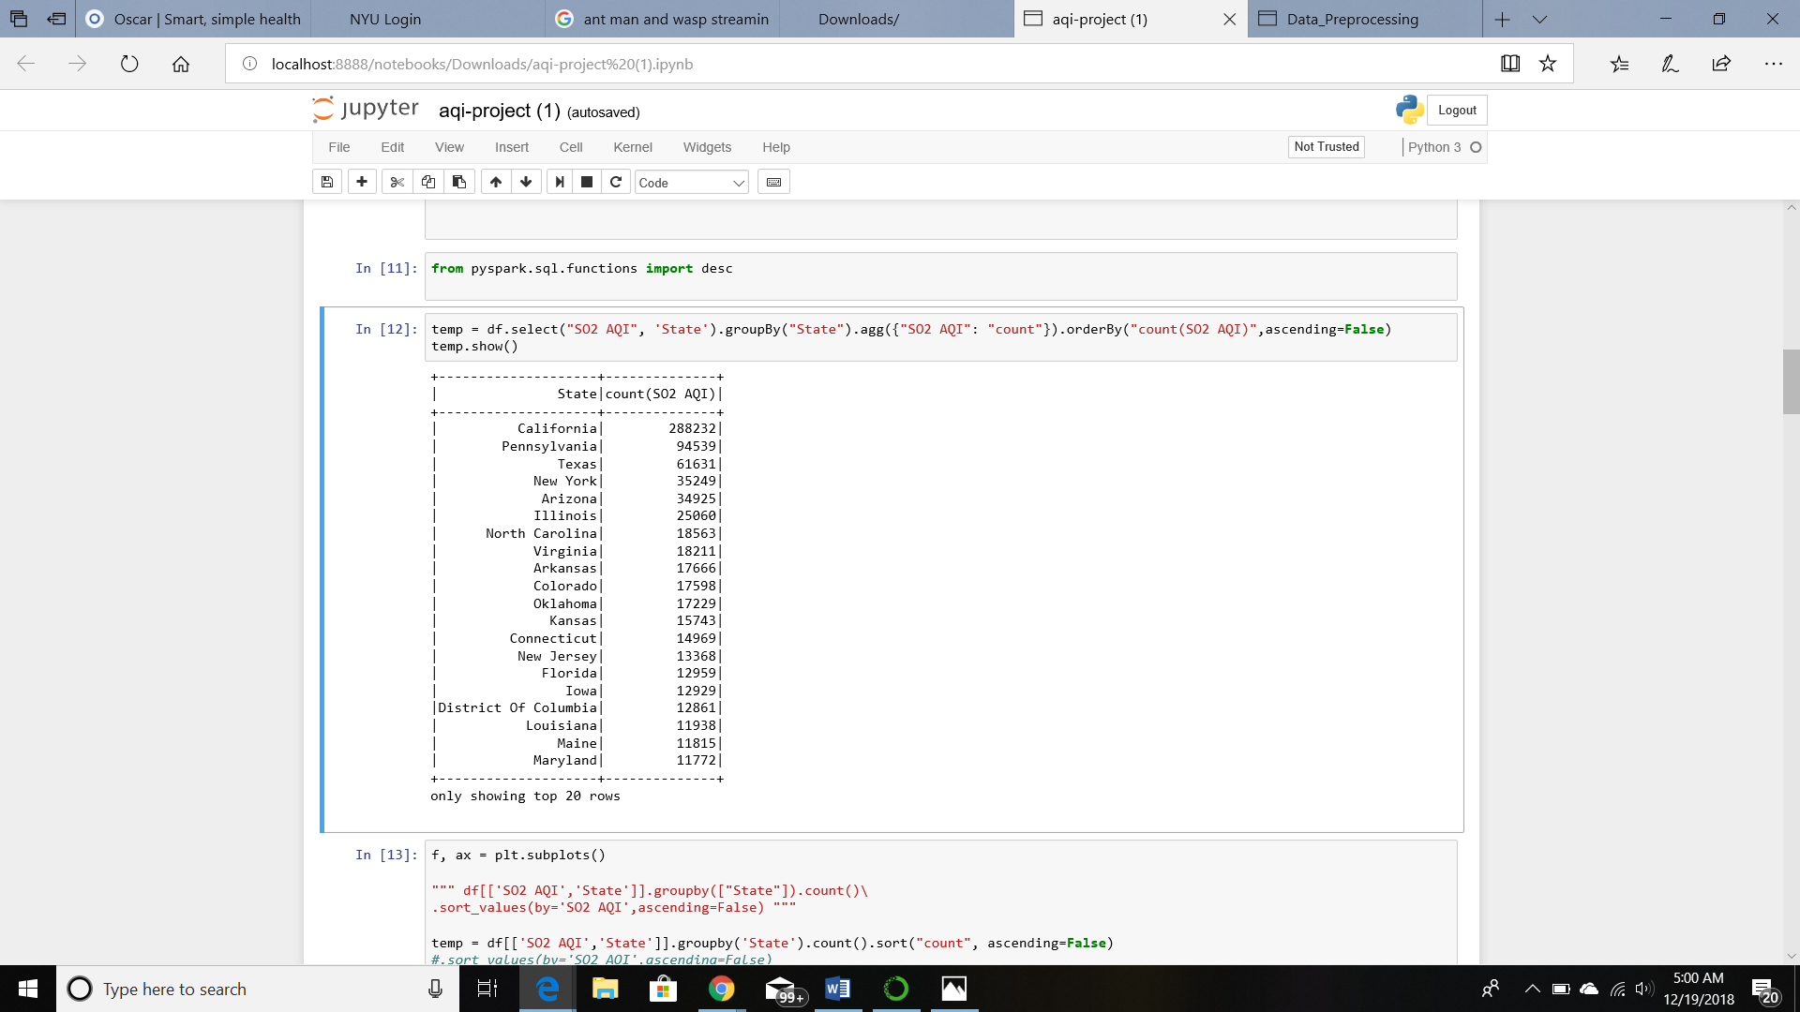
Multiple states are included in the dataset which further have thousands of data which can be used for different visualizations .

Slide 8
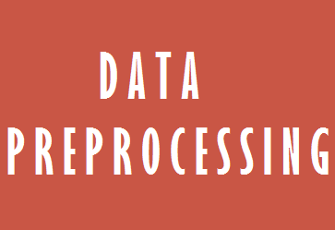
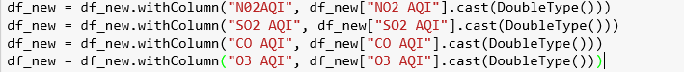
Preprocessing and Analysis
The first and most important part of the preprocessing was to change the data type of certain columns so that querying could be employed on the same.

Slide 9
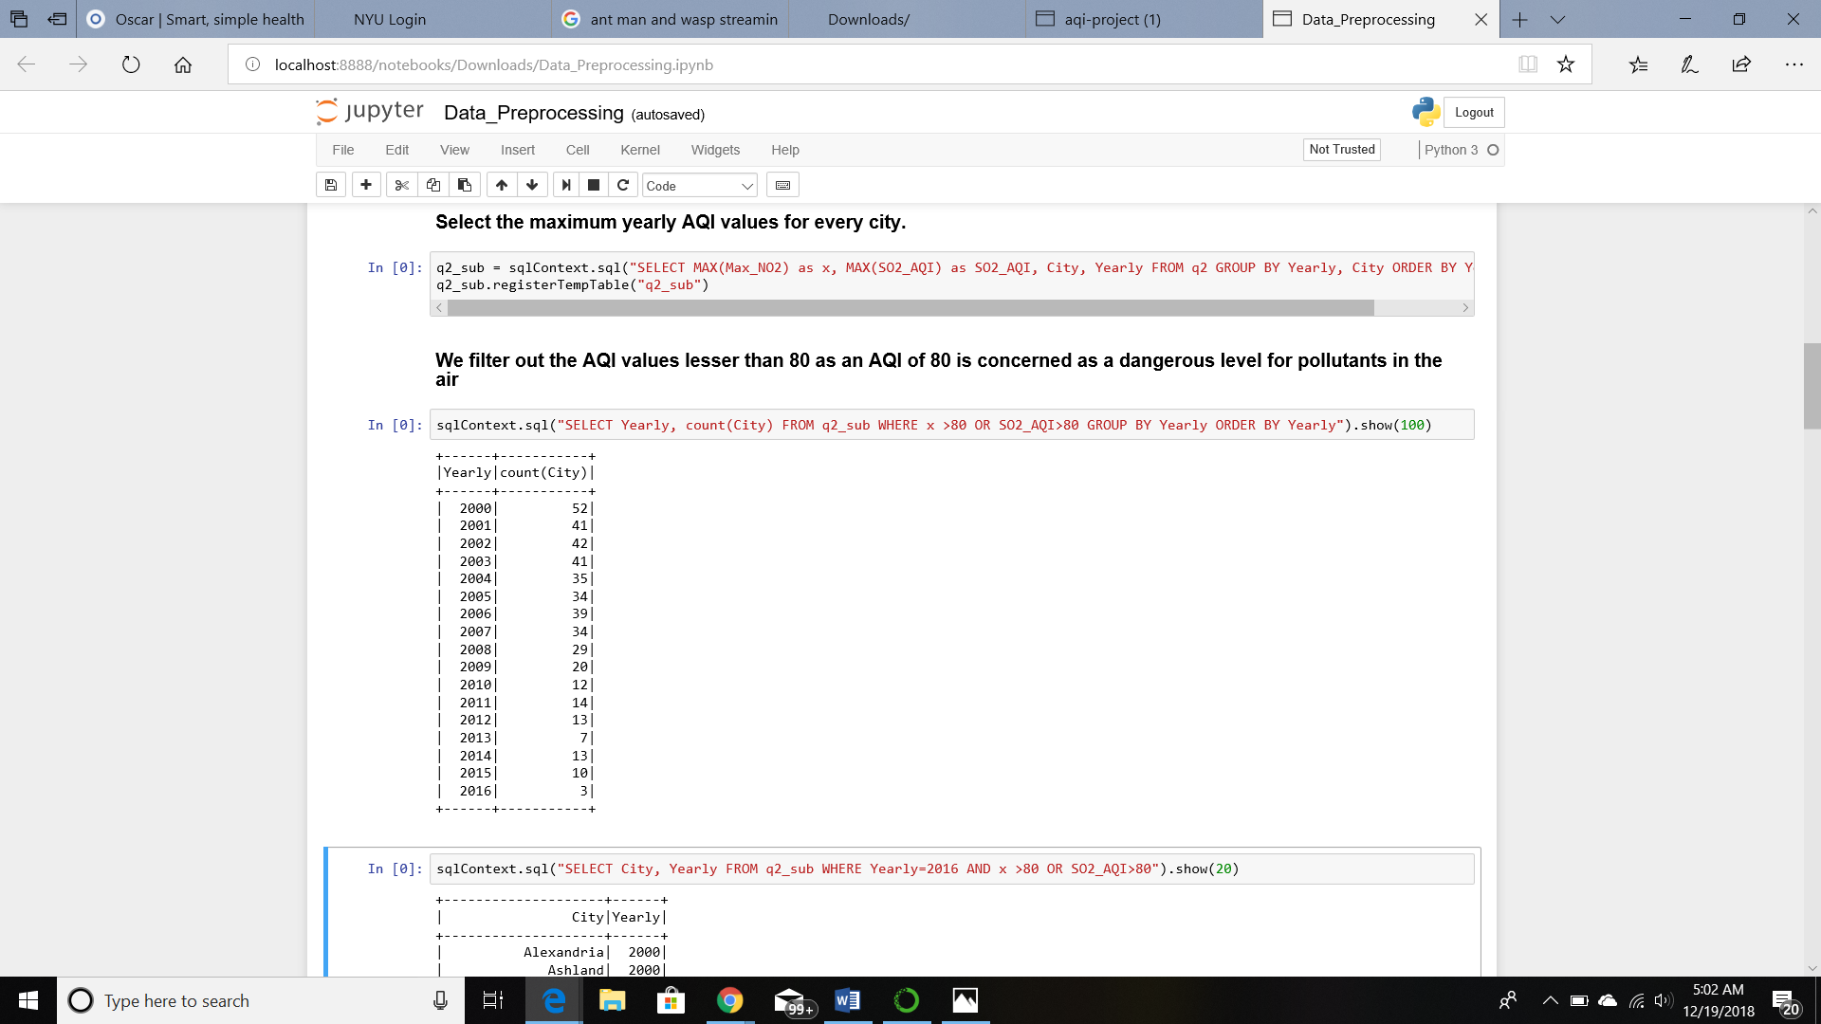
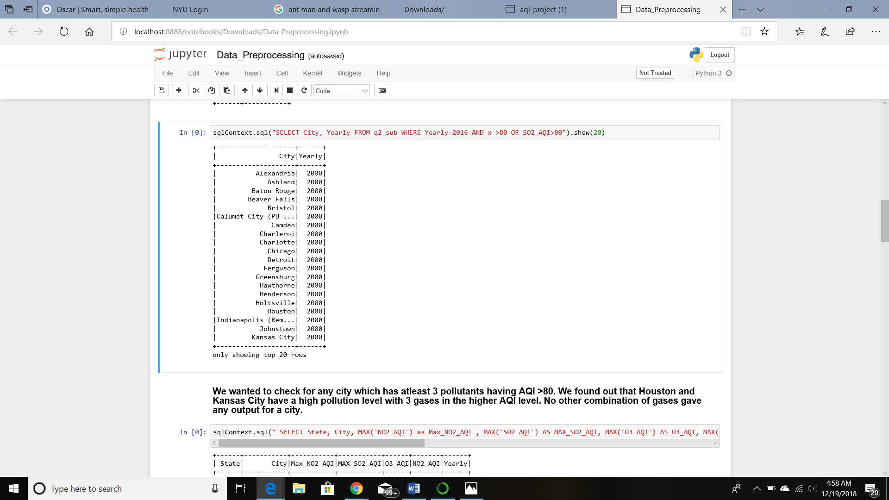
It is observed that there are various levels of NO₂ AQI and SO₂ AQI. We focus on selecting the daily maximum levels for every day of every month ranging from years 2000-2016. After doing the previous query, we focus on getting the maximum AQI values for every city. These AQI values are then filtered to eliminate all the values with less than 80 value.
Same analysis done with states

Slide 10
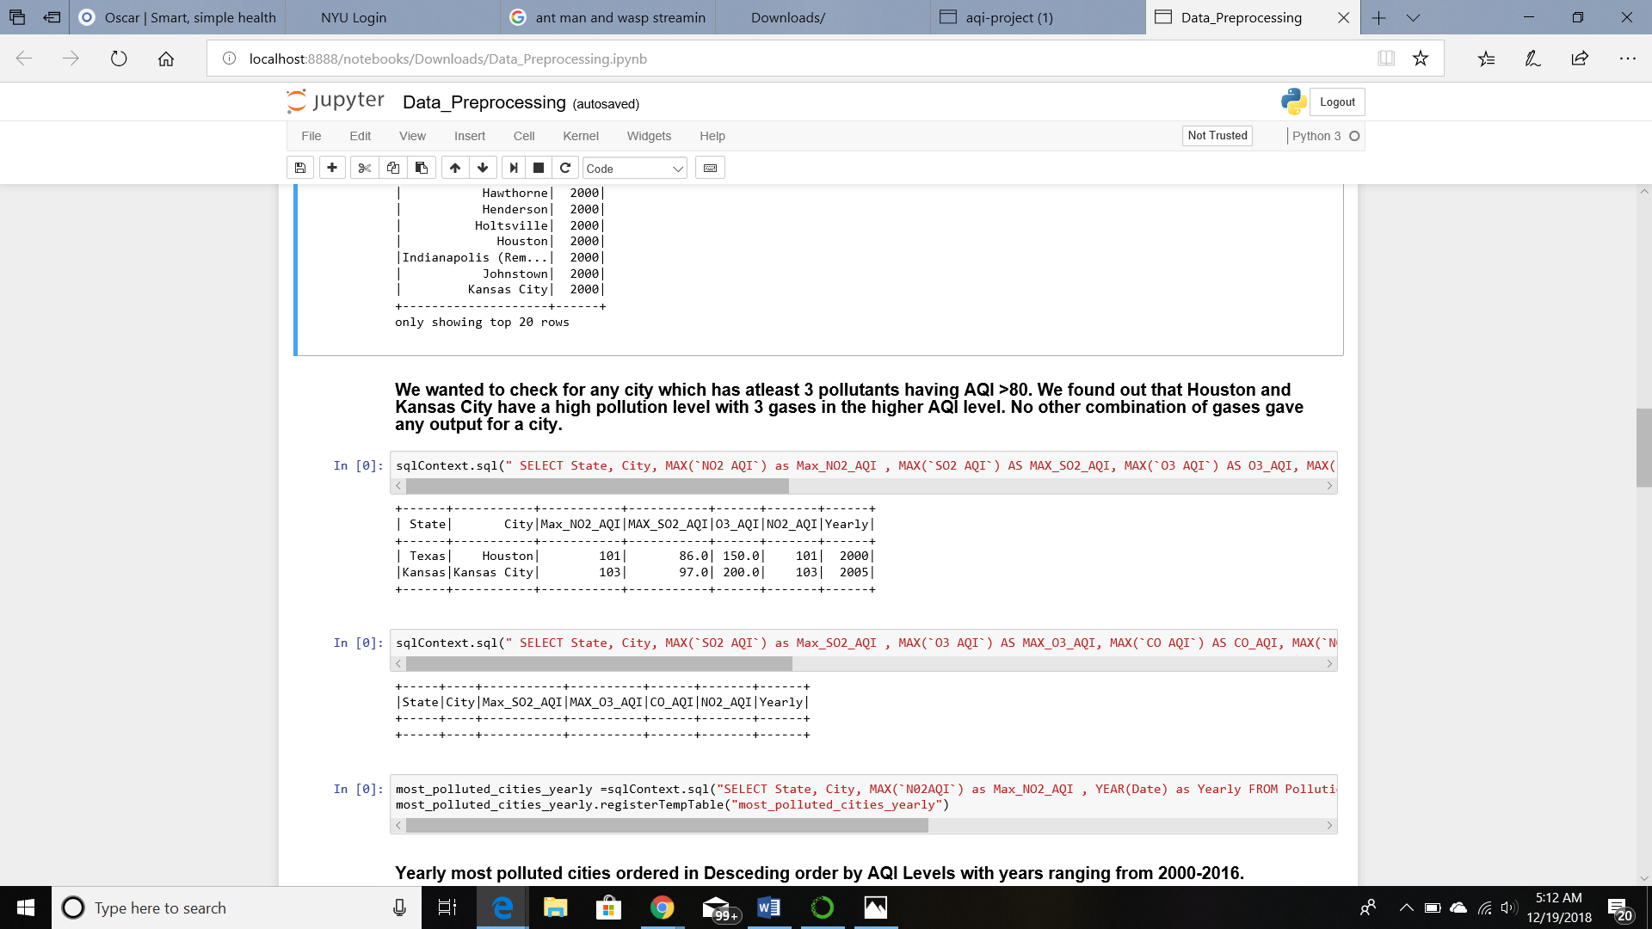
All the above preprocessing was done so that an analysis could be done to check for any city that has atleast 3 pollutants having AQI > 80. It was observed that Houston and Kansas City have a high pollution level with 3 gases in the higher AQI level

Slide 11
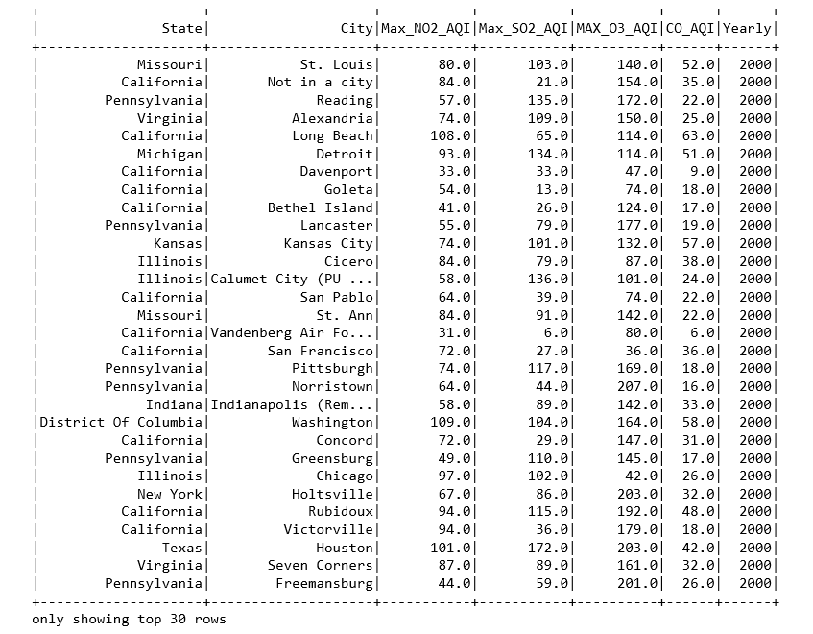
The above preprocessing was also done to analyze the most polluted cities in descending order by AQI levels with years ranging from 2000-2016.

Slide 12
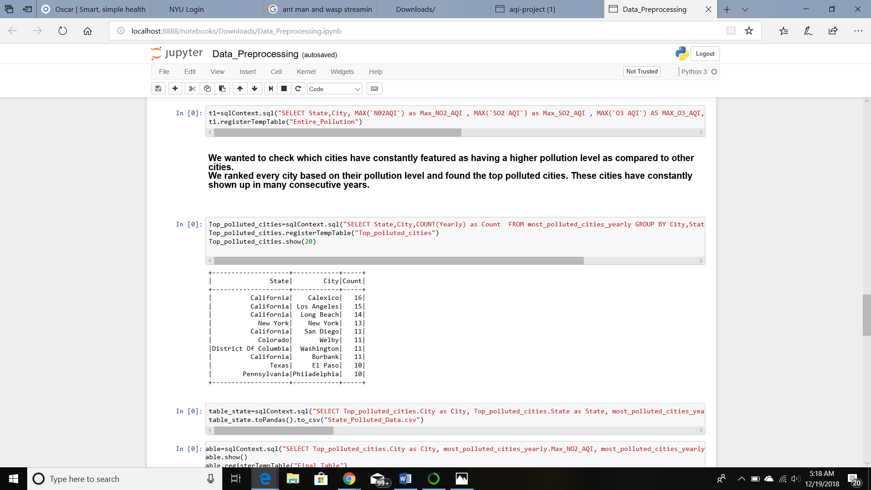
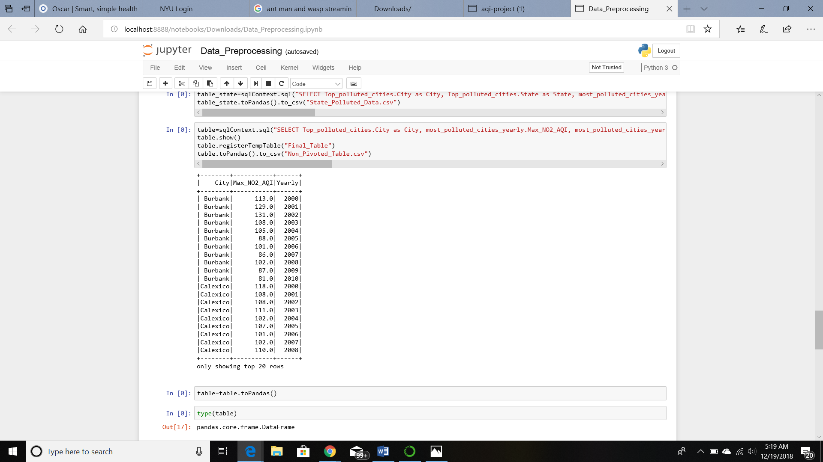
The above table helps in checking which cities have constantly featured as having a higher pollution level as compared to other cities. Every city was ranked on the basis of pollution level and the top polluted cities were found
An analysis can also be done on specific pollutants and the table for the same was also produced. As an example, NO₂ as a pollutant gave the following table

Slide 13
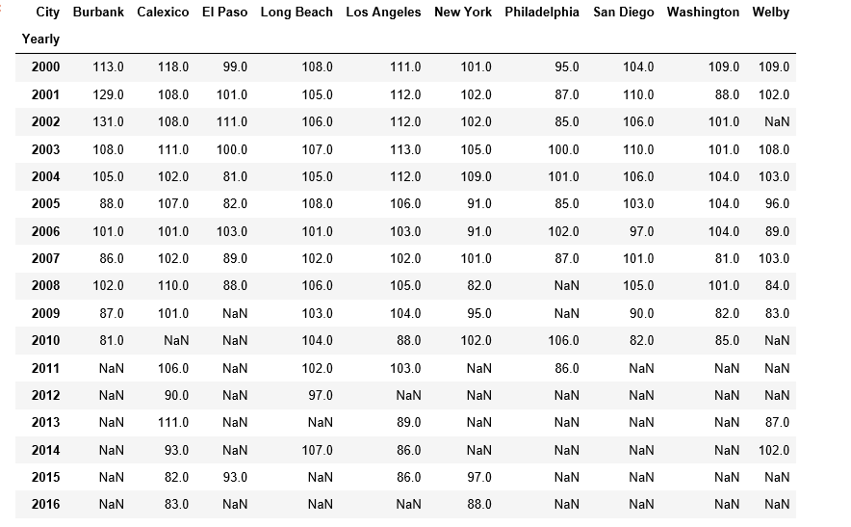
The table was also pivoted based on cities, with their AQI values as rows to provide another perspective

Slide 14
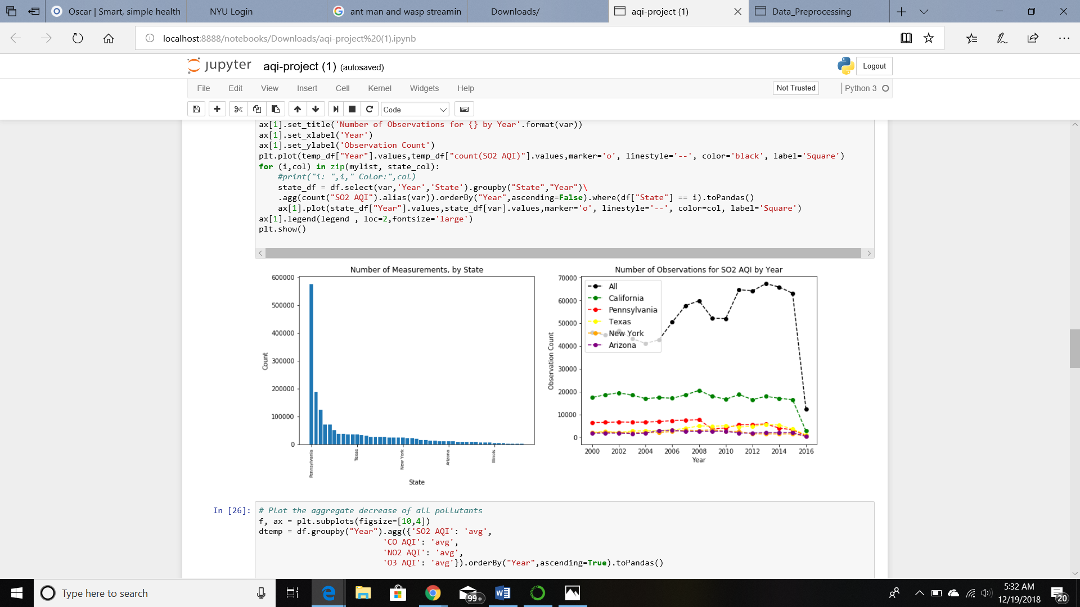
Visualization
The observation was seen with respect to the years. The count however, for each state can be separated with the help of different colors making the graph more readable

Slide 15
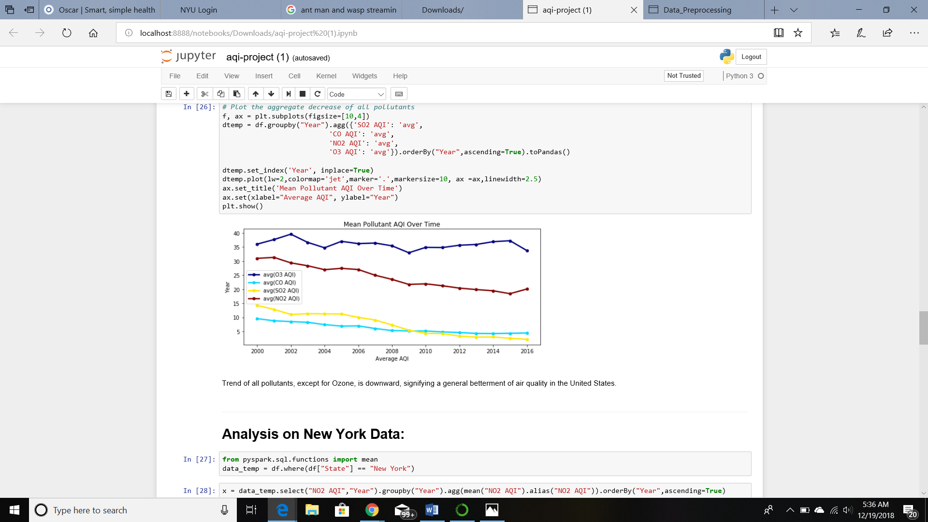
The data was also manipulated in such a way to produce a visualization of mean pollutant AQI over time

Slide 16
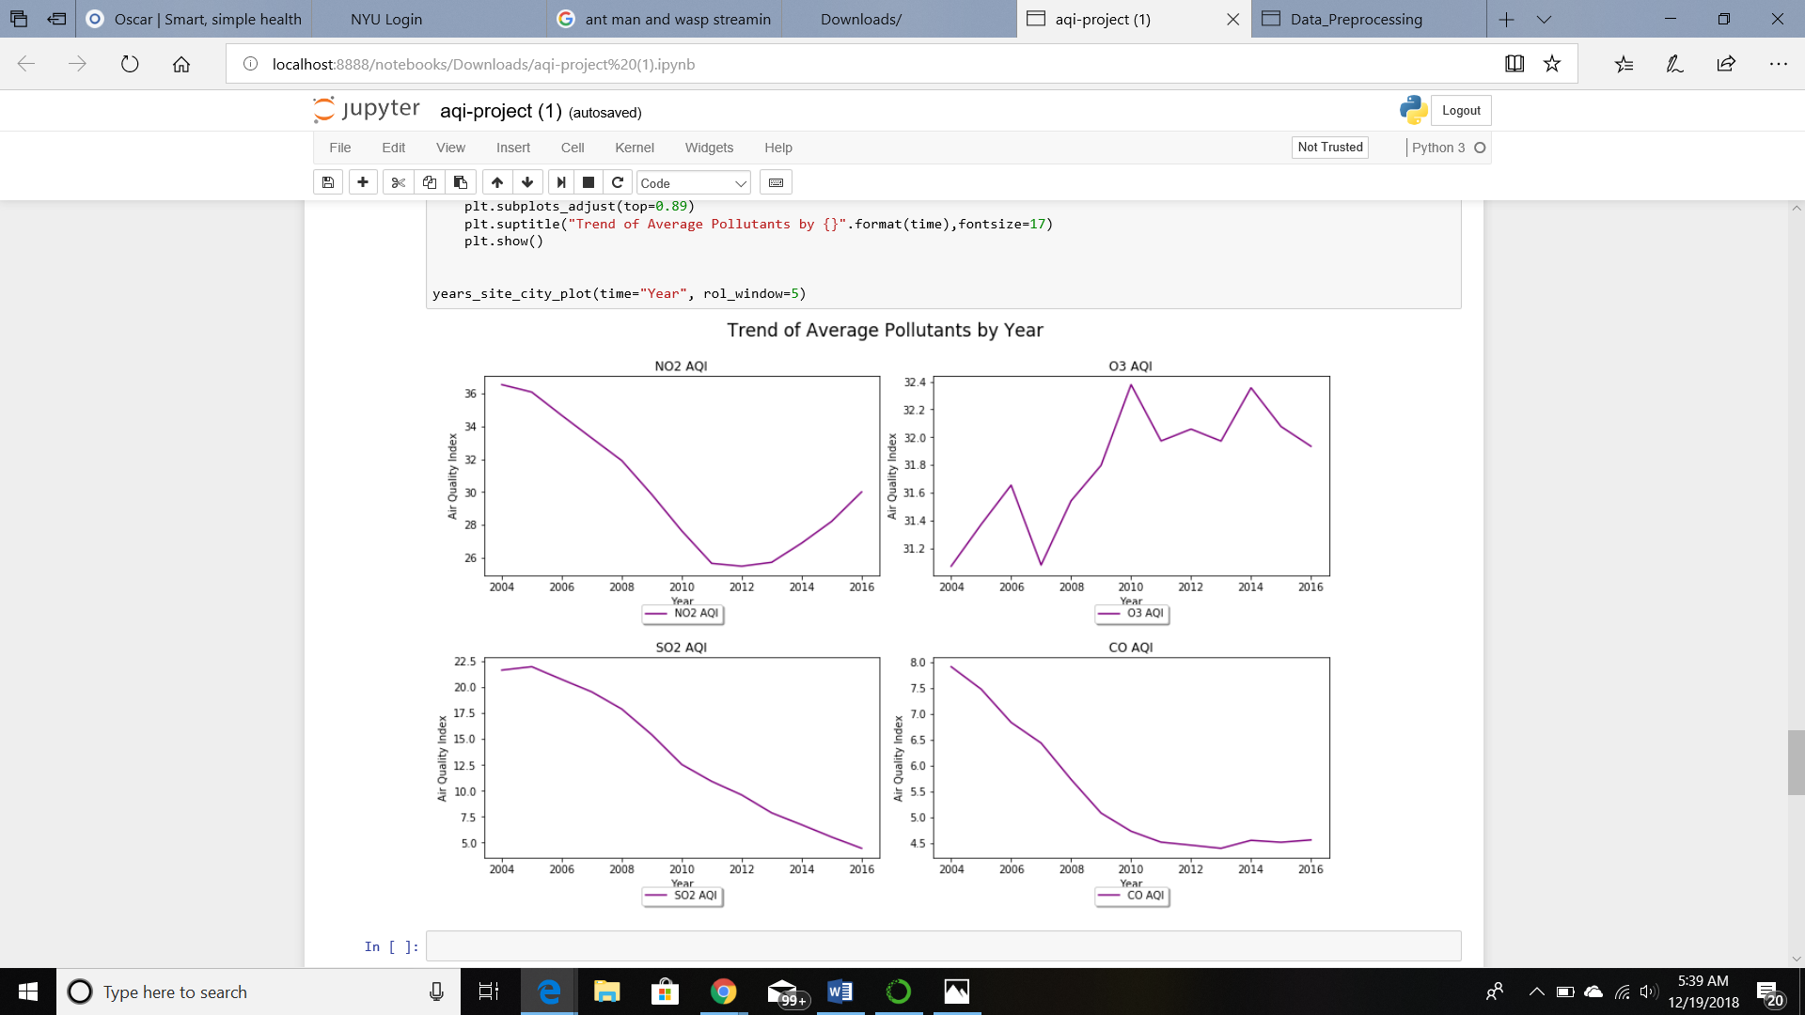
Analysis can be done on many different states, but we have chosen to show New York and California to highlight the trend of average pollutants by year.
New York

Slide 17
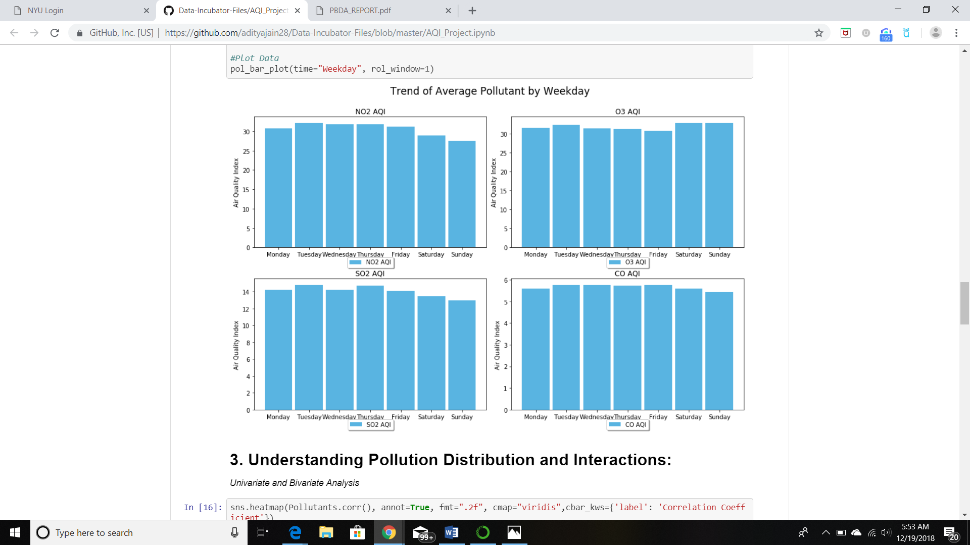
Average pollutant by weekday

Slide 18
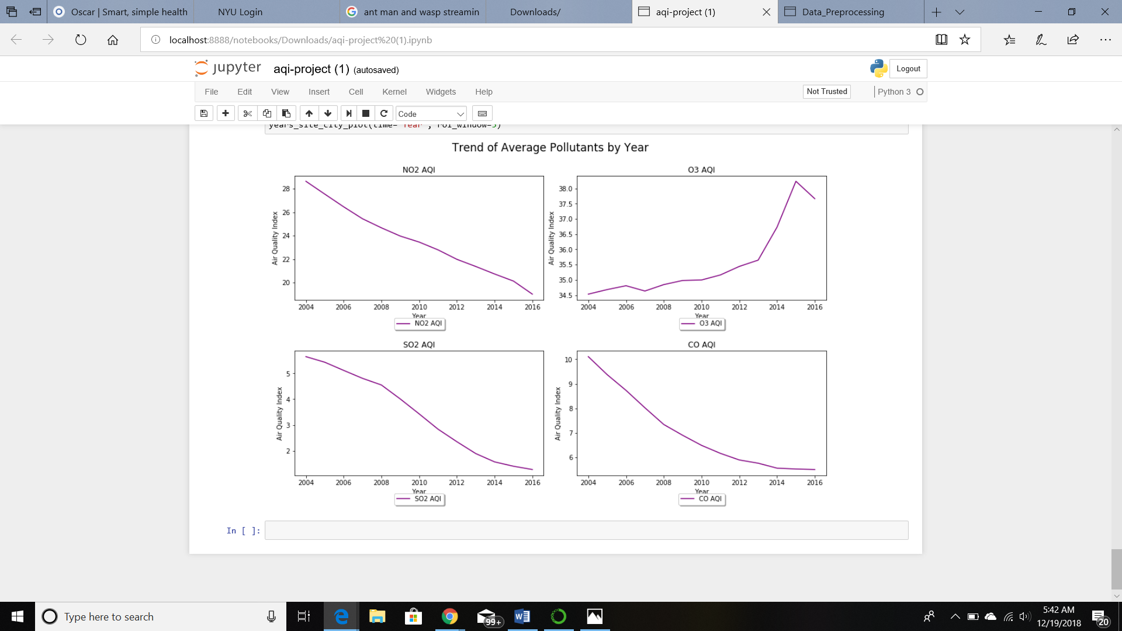
California

Slide 19
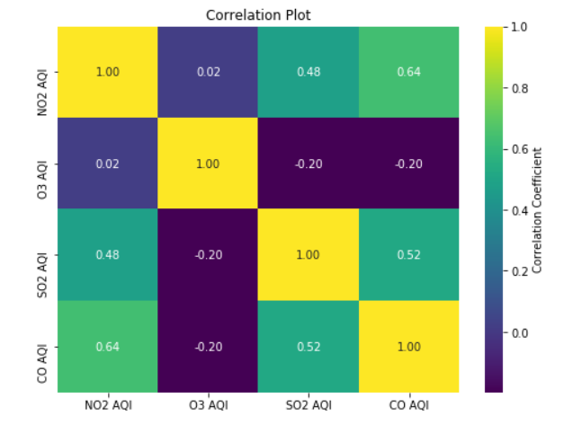
A correlation plot is also constructed to get a better idea about how different pollutants are being correlated each other.
The above virtualization helped in inferring that CO and NO₂ AQI have the highest correlation (positive) out of all

Slide 20
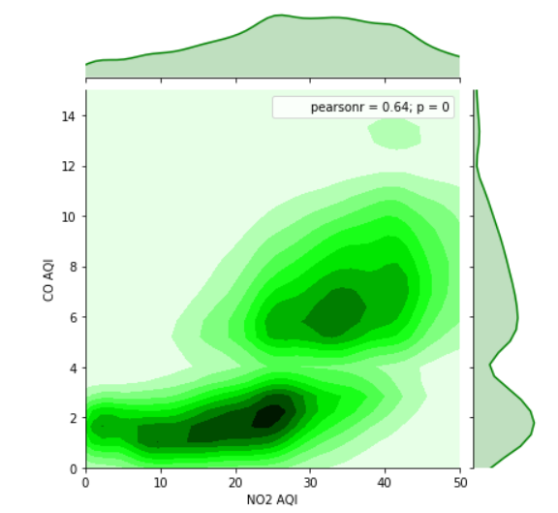
A 2D distribution of the same correlation can be visualized with the help of a 2D heat map. However, if this virtualization is used, only 2 pollutants correlation is checked at a time
The above 2D correlation helped in inferring that as the carbon dioxide was increasing, at the same time Nitrogen Oxide was also increasing.

Slide 21
SUMMARY
-Strong Correlation was found to exist between different pollutants such as CO and NO2 which was observed in the correlation map. This correlation was further checked with the help of a 2D heat map which showed that with an increase in CO, there was an increase in NO2.
-It was analyzed that except for Ozone , the trend of all other pollutants is downward. This showed that the air quality was getting better in general in United States except for the condition of Ozone pollutant.
-Kansas City and Houston were the only 2 states found to have all 4 gases ( NO2,SO2,O3,CO) to be above 80(hazardous AQI level) between the years 2000 and 2016.

Slide 22
Problems we faced
-Setting up the infrastructure to run required services on HPC.
-Setting up MongoDB and OpenAPI/Google Bigquery on HPC.
-Data type casting problem for columns of PySpark dataframes
-Identifying the data features to manipulate, filtering out values to produce a visualization to get a better perspective.

Slide 23
Future Scope
-Setting up Kafka and integrating OpenAPI or Google Big Query to get up to date results.
-Making an UI for users to interact and visualize as they want.
-Adding more Countries to the dataset.

Slide 24


